Slide 1
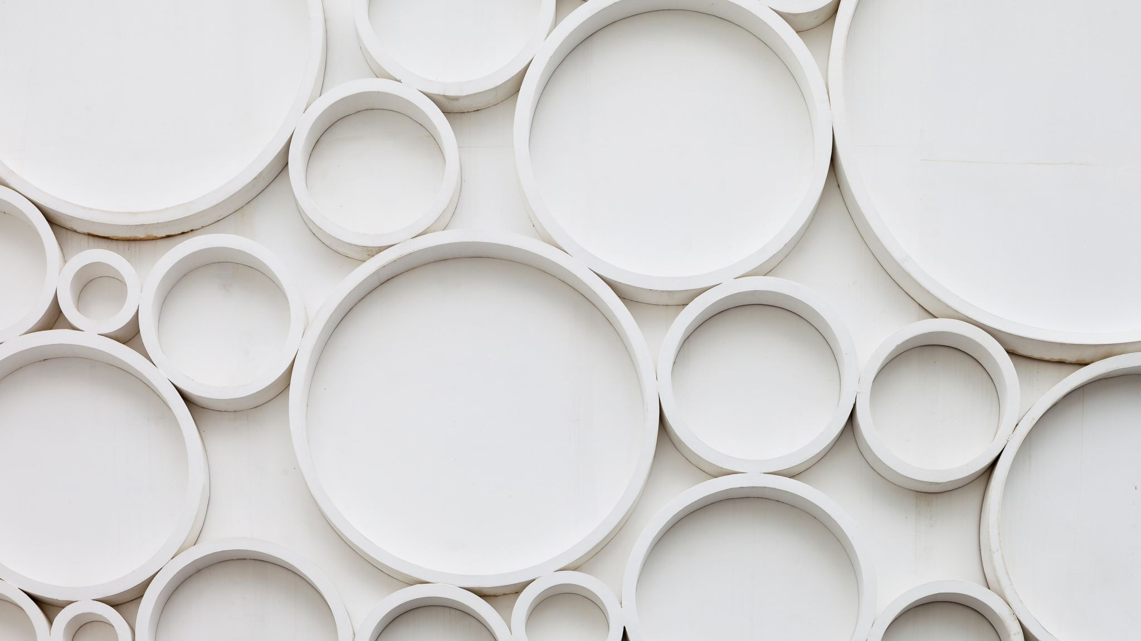
Meeting 3/19
Jieqi and nelson

Slide 2
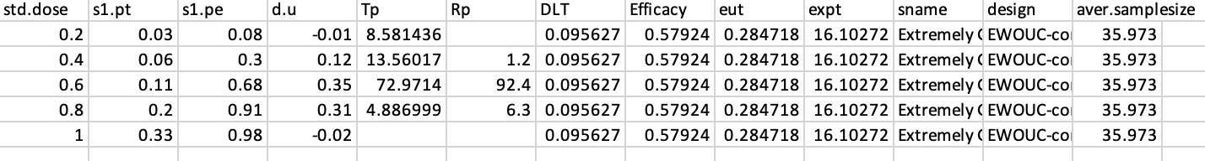
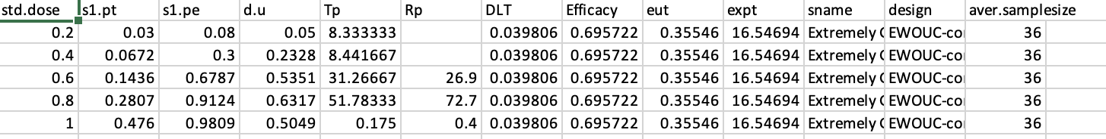
Comparison of simulation results between EWOUC and EWOUC-NETS
EWOUC: Complete scenario (scenario 1)
EWOUC-NETS: Complete scenario (scenario 1)

Slide 3
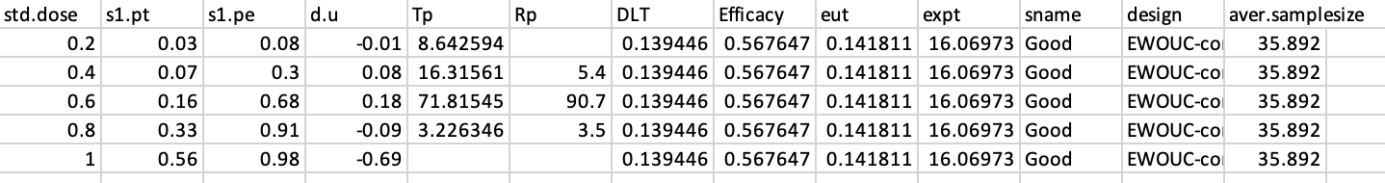
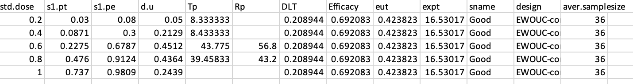
Comparison of simulation results between EWOUC and EWOUC-NETS
EWOUC: Complete scenario (scenario 2)
EWOUC-NETS: Complete scenario (scenario 2)

Slide 4
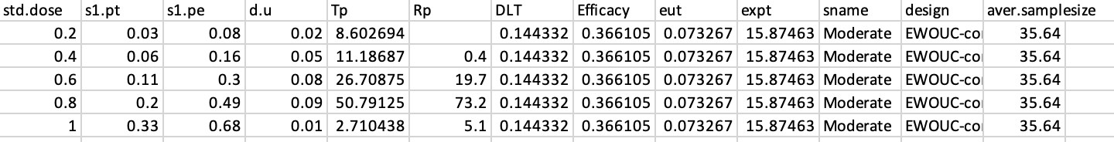
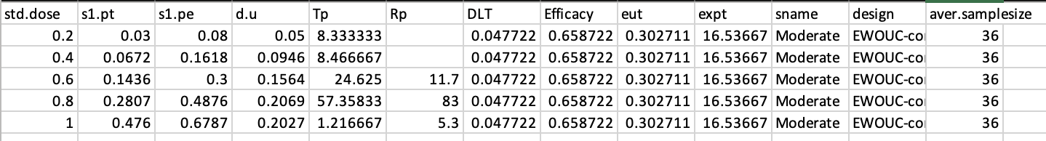
Comparison of simulation results between EWOUC and EWOUC-NETS
EWOUC: Complete scenario (scenario 3)
EWOUC-NETS: Complete scenario (scenario 3)

Slide 5
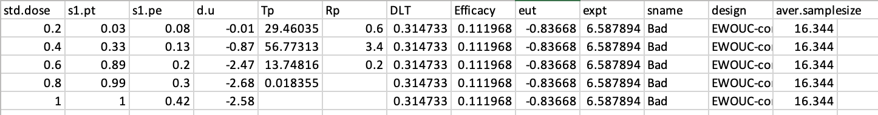
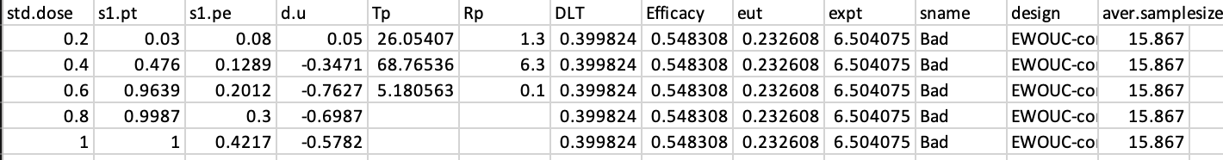
Comparison of simulation results between EWOUC and EWOUC-NETS
EWOUC: Complete scenario (scenario 4)
EWOUC-NETS: Complete scenario (scenario 4)

Slide 6
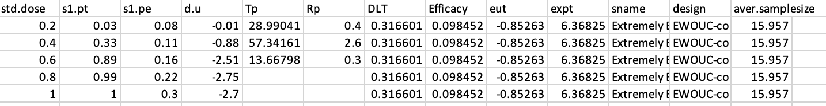
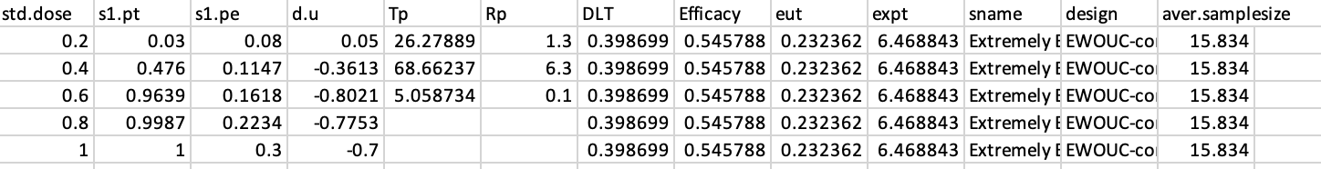
Comparison of simulation results between EWOUC and EWOUC-NETS
EWOUC: Complete scenario (scenario 5)
EWOUC-NETS: Complete scenario (scenario 5)

